Slide 1
STT 6300
Chapter 8: Regression

Slide 2
Introduction
A very common problem in scientific studies is to determine how one variable depends on one or more other variables. For example, is a hurricane’s wind speed related to the ocean water temperature? If so, what is the relationship?
Think back to the pelican egg example where data was collected on eggshell thickness and the level of PCB’s in the birds. A question of interest is whether or not the eggshell thickness depends on the PCB level and if so, how does the PCB level affect eggshell thickness? Again, regression analysis can be used to answer this question.

Slide 3
Introduction
Francis Galton is credited with originating the term regression when he studied how heights of children depended on the heights of their parents. Can we predict a child’s height based on the height of the child’s parents? Or, for parents of a particular height, what is the average height of their offspring? Linear regression is used to answer these types of questions.

Slide 4
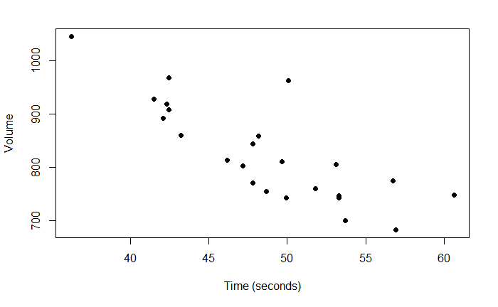

Introduction
Below is a scatterplot of time (in seconds) to run 2 miles versus maximum volume of $O_{2}$ uptake for a sample of middle-aged men.

Slide 5
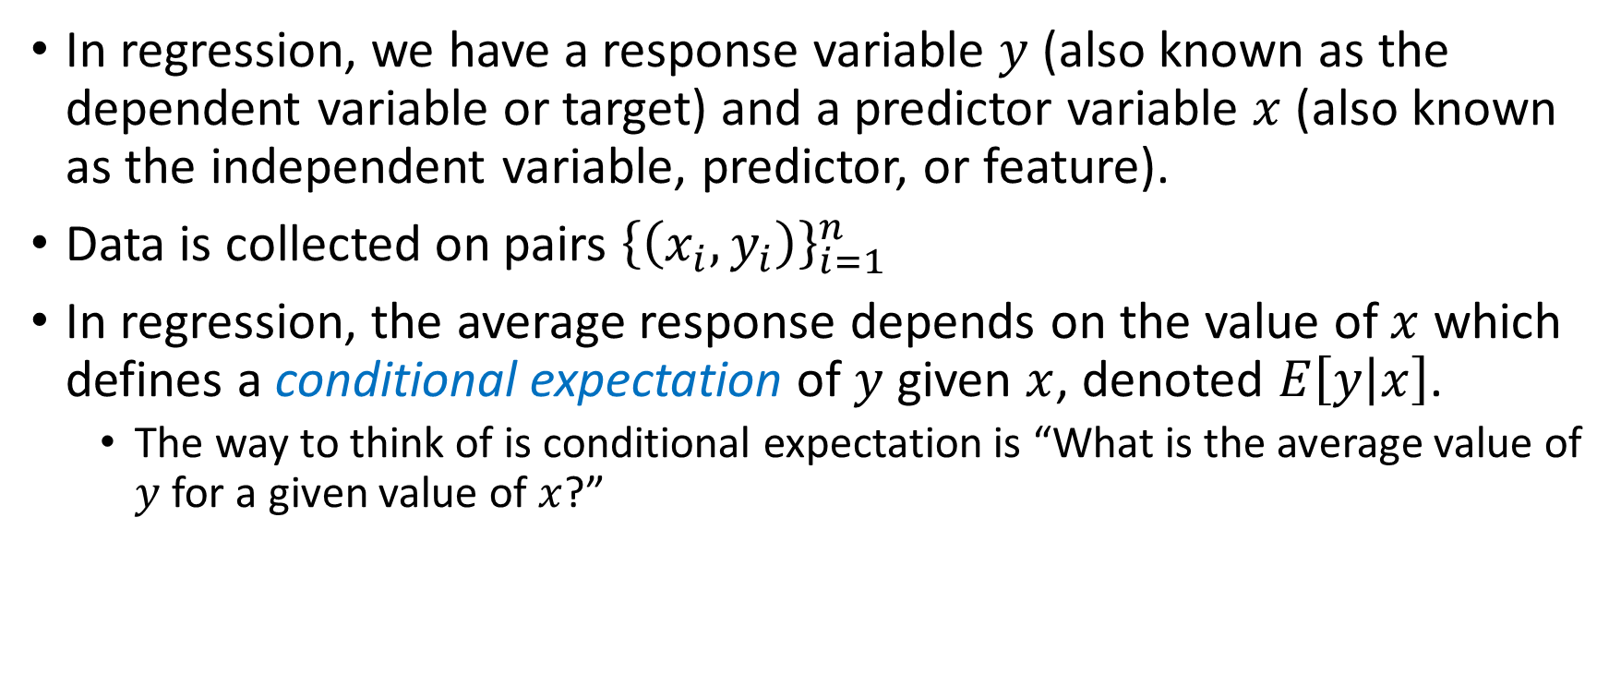
Simple linear regression
In regression, we have a response variable $y$ (also known as the dependent variable or target) and a predictor variable $x$ (also known as the independent variable, predictor, or feature).
Data is collected on pairs ${\left\{\left(x_{i}, y_{i}\right)\right\}}_{i=1}^{n}$
In regression, the average response depends on the value of $x$ which defines a conditional expectation of $y$ given $x$, denoted $E\left[y | x\right]$.
The way to think of is conditional expectation is “What is the average value of $y$ for a given value of $x$?”

Slide 6
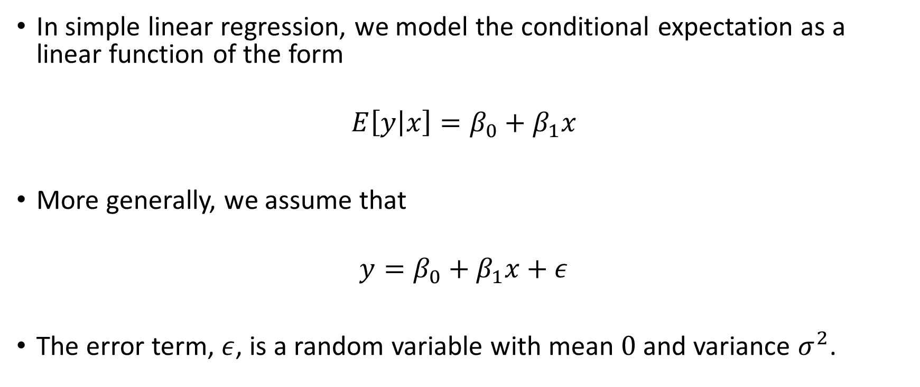
Simple linear regression
In simple linear regression, we model the conditional expectation as a linear function of the form
$$E\left[y | x\right]=β_{0}+β_{1}x$$
More generally, we assume that
$$y=β_{0}+β_{1}x+ε$$
The error term, $ε$, is a random variable with mean $0$ and variance $σ^{2}$.

Slide 7
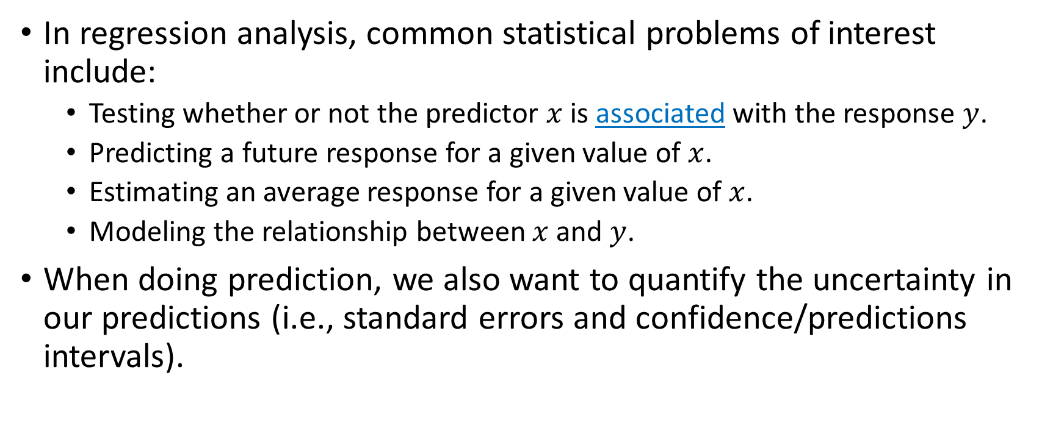
Simple linear regression
In regression analysis, common statistical problems of interest include:
Testing whether or not the predictor $x$ is associated with the response $y$.
Predicting a future response for a given value of $x$.
Estimating an average response for a given value of $x$.
Modeling the relationship between $x$ and $y$.
When doing prediction, we also want to quantify the uncertainty in our predictions (i.e., standard errors and confidence/predictions intervals).

Slide 8
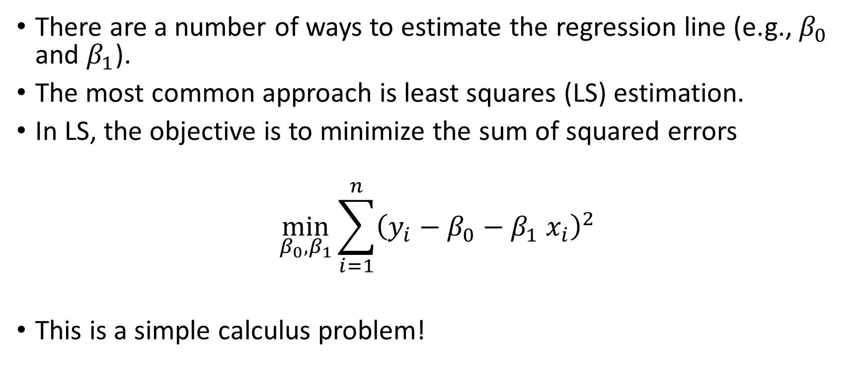
How do we estimate the regression line??
There are a number of ways to estimate the regression line (e.g., $β_{0}$ and $β_{1}$).
The most common approach is least squares (LS) estimation.
In LS, the objective is to minimize the sum of squared errors
$$\min_{β_{0}, β_{1}}{\sum_{i=1}^{n}{{\left(y_{i}−β_{0}−β_{1} x_{i}\right)}^{2}}}$$
This is a simple calculus problem!

Slide 9

Simple linear regression
Calculus can be used to show that
$${\hat{β}}_{1}=\frac{\sum_{i=1}^{n}{\left(x_{i}−\overline{x}\right)\left(y_{i}−\overline{y}\right)}}{\sum_{i=1}^{n}{{\left(x_{i}−\overline{x}\right)}^{2}}}$$
$${\hat{β}}_{0}=\overline{y}−{\hat{β}}_{1}\overline{x}$$
For a given data point

